Slide 1


Global air pollution modelling
University of Utrecht, The Netherlands
Global and geo-health data center
Meng Lu

Slide 2
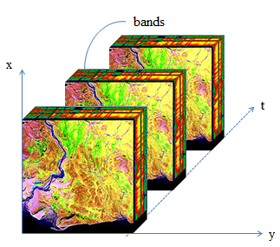
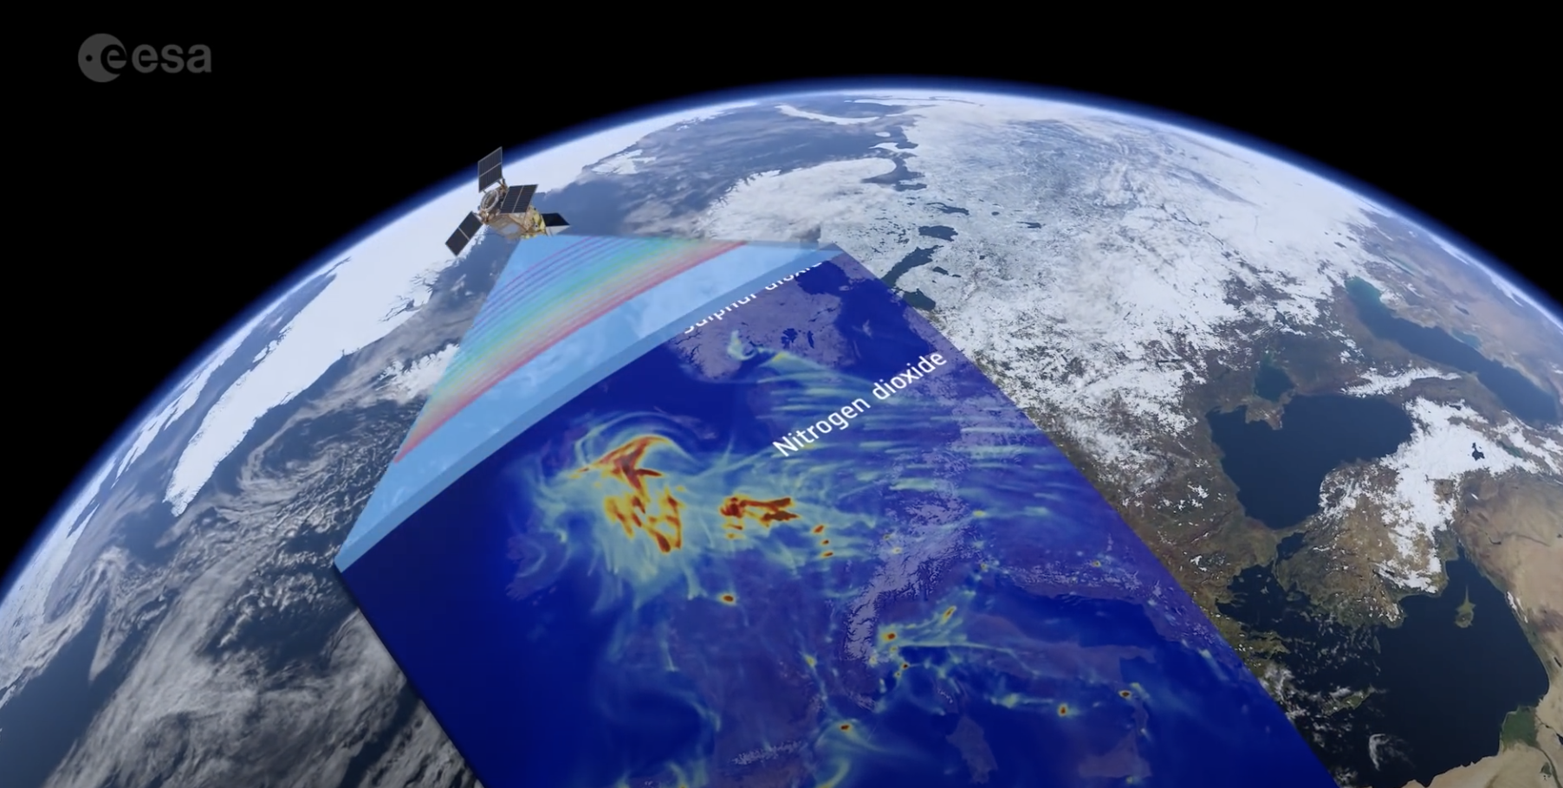
Me
Remote sensing and information engineering
Spatiotemporal change modelling from multidimensional arrays
Spatiotemporal data analysis
Remote sensing
Image analysis
Exposure assessment
Mapping

Slide 3

Goal: Global, high spatiotemporal resolution NO₂ mapping NO₂: is part of a group of gaseous air pollutants produced as a result of road traffic and other fossil fuel combustion processes.

Slide 4
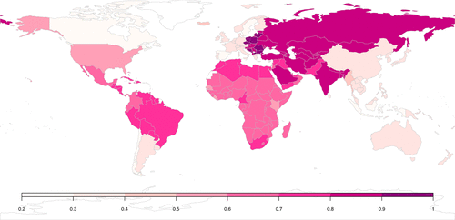
Why global?
Estimation of global burden of disease
to monitor the UN established Sustainable Development Goals
Consistent epidemiological studies world-wide
Inequality in health and air pollution monitors in middle and low income countries
Shaddock et al., 2018

Slide 5

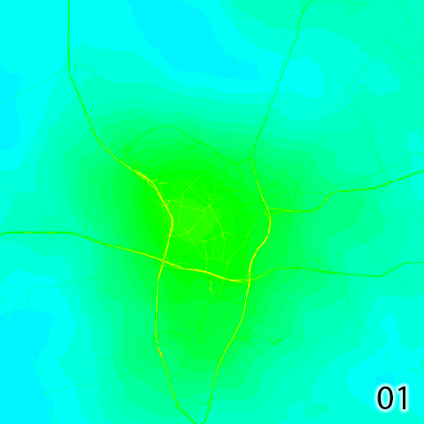
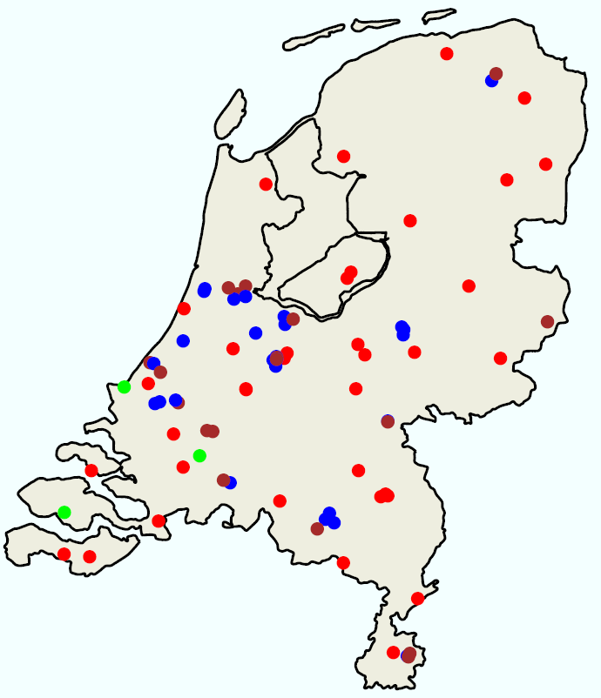
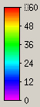

Why high spatial and temporal resolutions?
60
30
RURAL
TRAFFIC
INDUSTRY
Hourly/minutes
LML data (landelijk meetnet luchtkwaliteit)
0
Hour
0
5km

Slide 6
Air pollution modelling methods
Process-based models:
Air dispersion models
Chemical transportation models
Statistical-based methods:
Information form predictors, spatiotemporal dependence.

Slide 7
Geospatial predictors
Road and industrial area from OpenStreetMap (vector)
Earth nightlight (500 m)
as a proxy for socio-demographics
Population (100 m)
From human settlement layers
Wind speed and temperature
Elevation: SRTM (90 m)

Slide 8
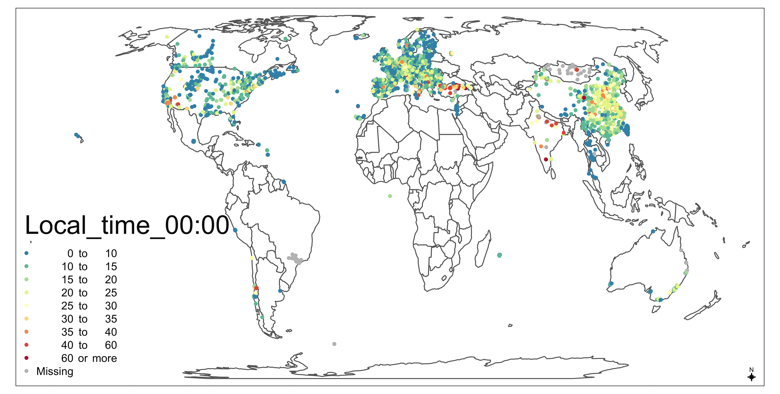
Ground monitor measurements:
OpenAQ: an open science air quality community
Through collaboration: China, Australia, Canada, US, EU

Slide 9

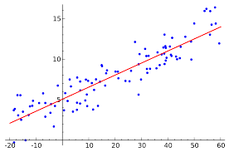




Machine learning vs. Linear regression models
Global models Vs. National models
Daytimg models Vs. Nighttime models
Lu, M. Schmitz, O., Van de Hoogh, K., Qin, K., & Karssenberg, D. Evaluation of different methods and data sources to optimise modelling of NO2 at a global scale. Environmental international

Slide 10
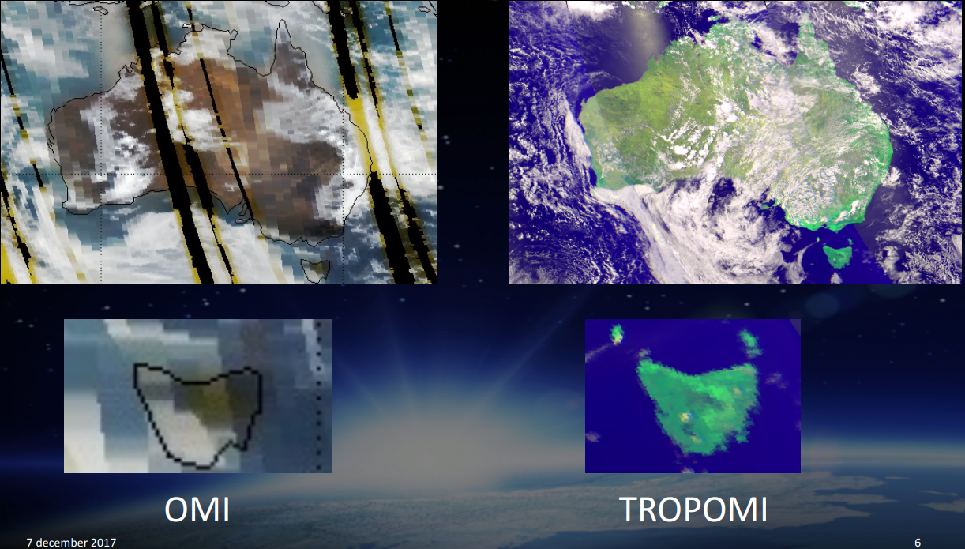

Tropomi
(TROPOspheric Monitoring Instrument)
Launched Oct. 2017,
Resolution (NO2)
2018-2019: 7 km
Since Oct. 2019: 5.5 km
Measurements: NO₂, O₃ (7km × 28km), SO₂, methane and CO
Souce [3]

Slide 11
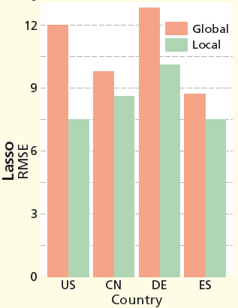
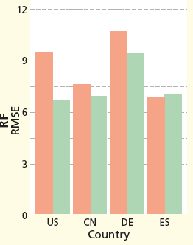
Global Vs. National models
Random Forest
Lasso
RF: random forest
CN: China
DE: Germany
ES: Spain

Slide 12
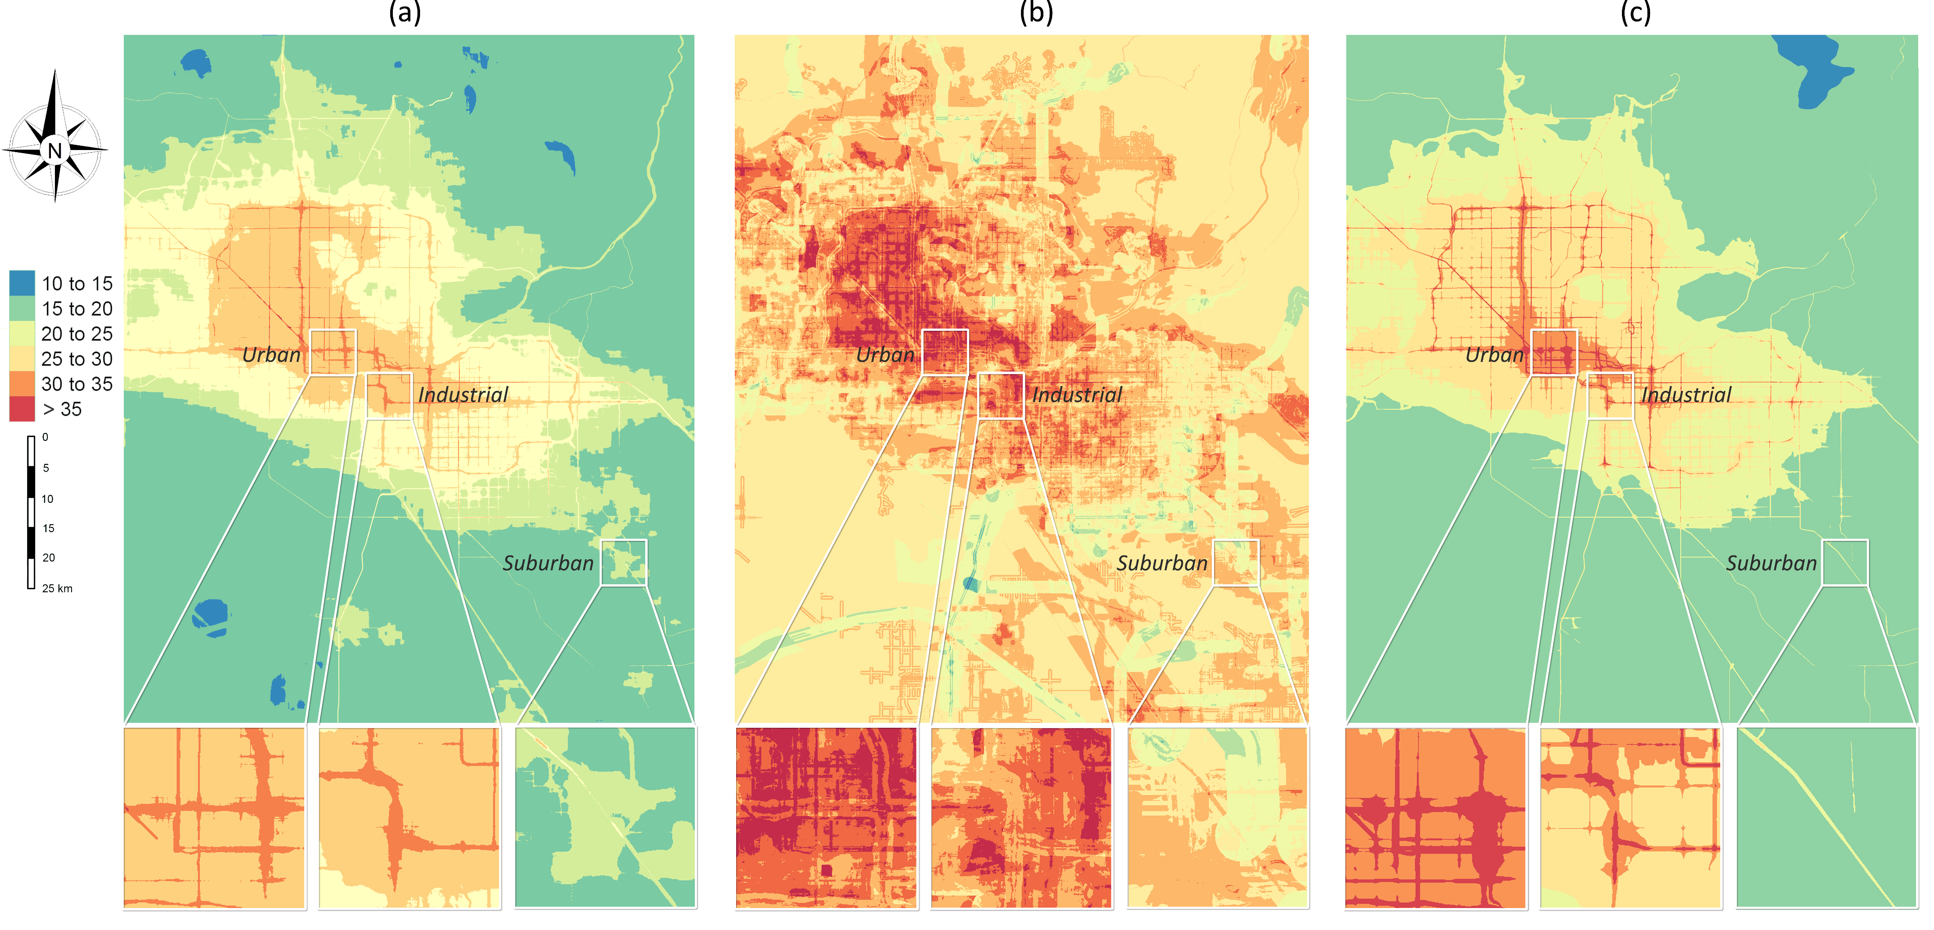
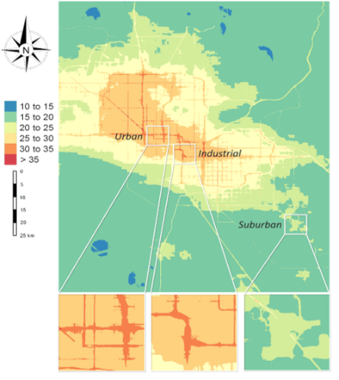


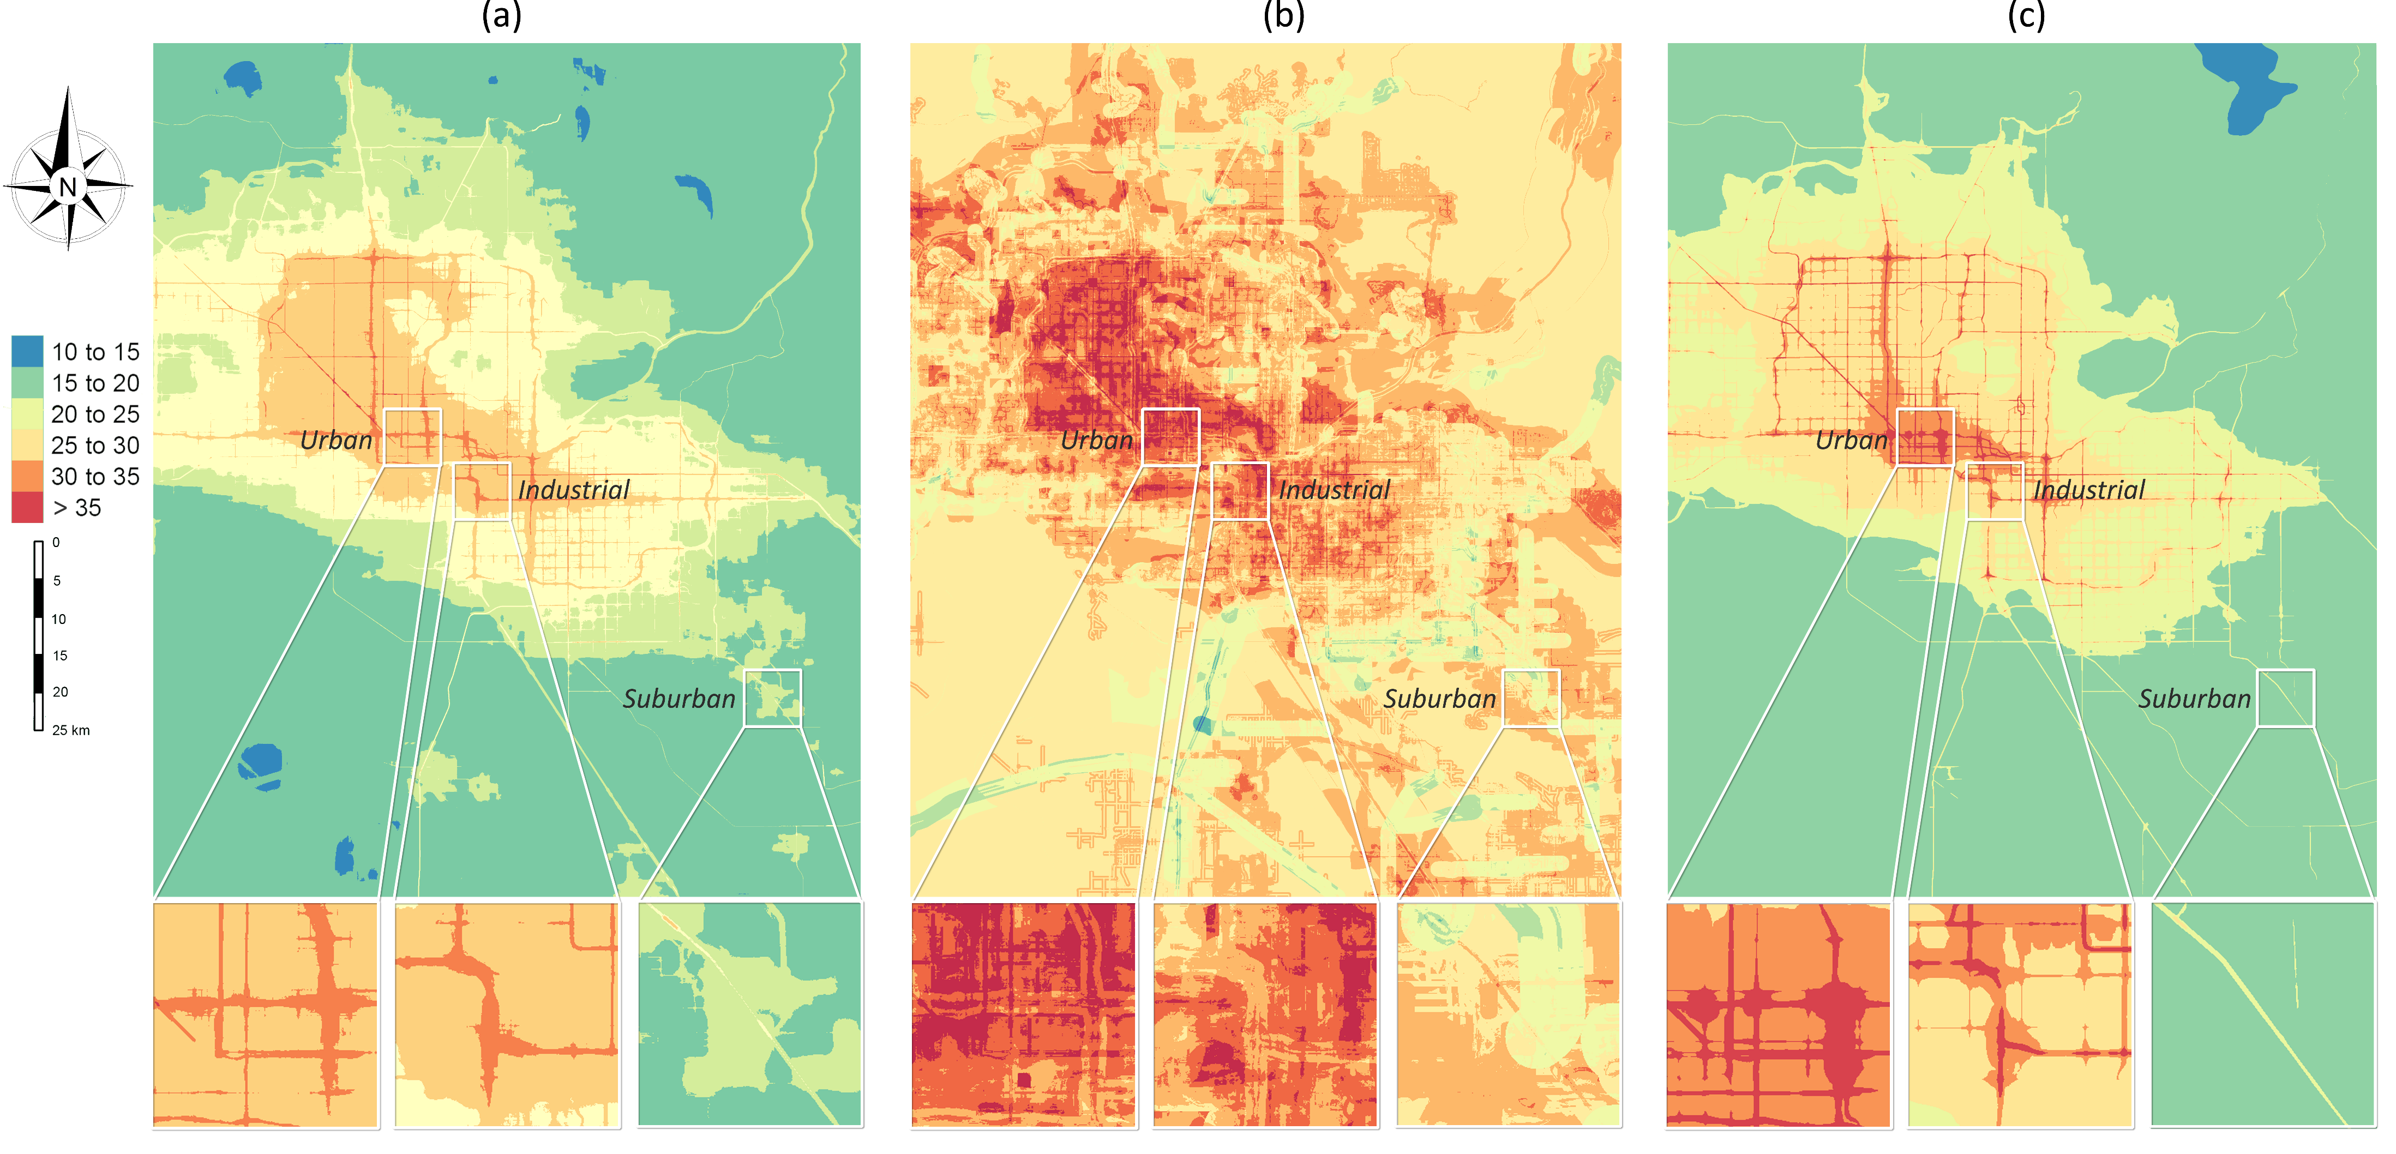

Random Forest
LASSO
NO₂ (µg/$m^{3})$
Phoenix area, Arizona, USA

Slide 13
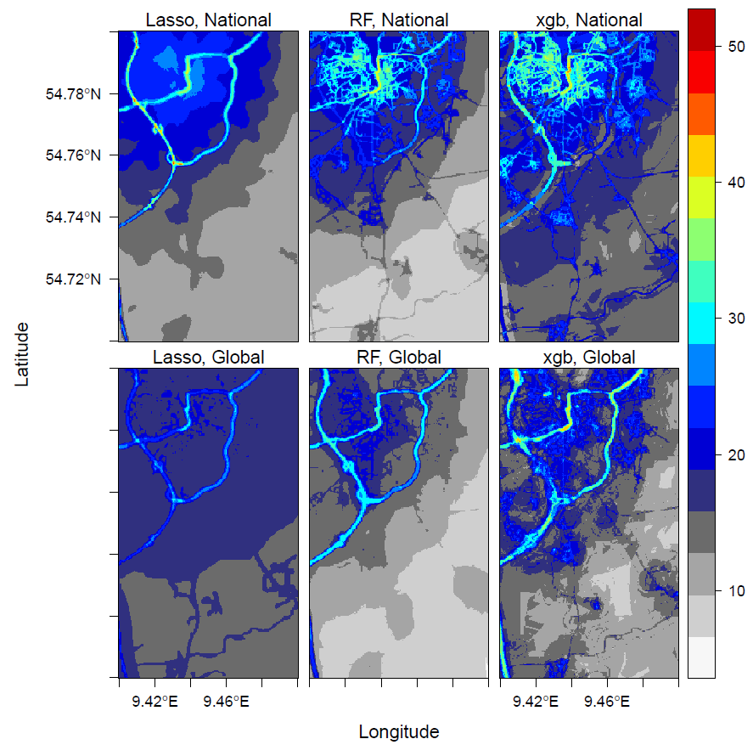
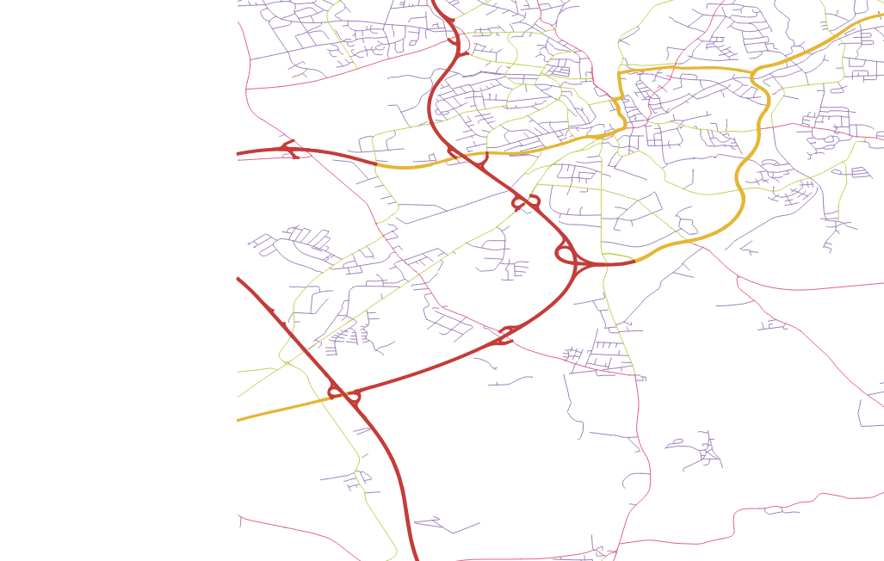
Prediction Patterns
highway
primary

Slide 14
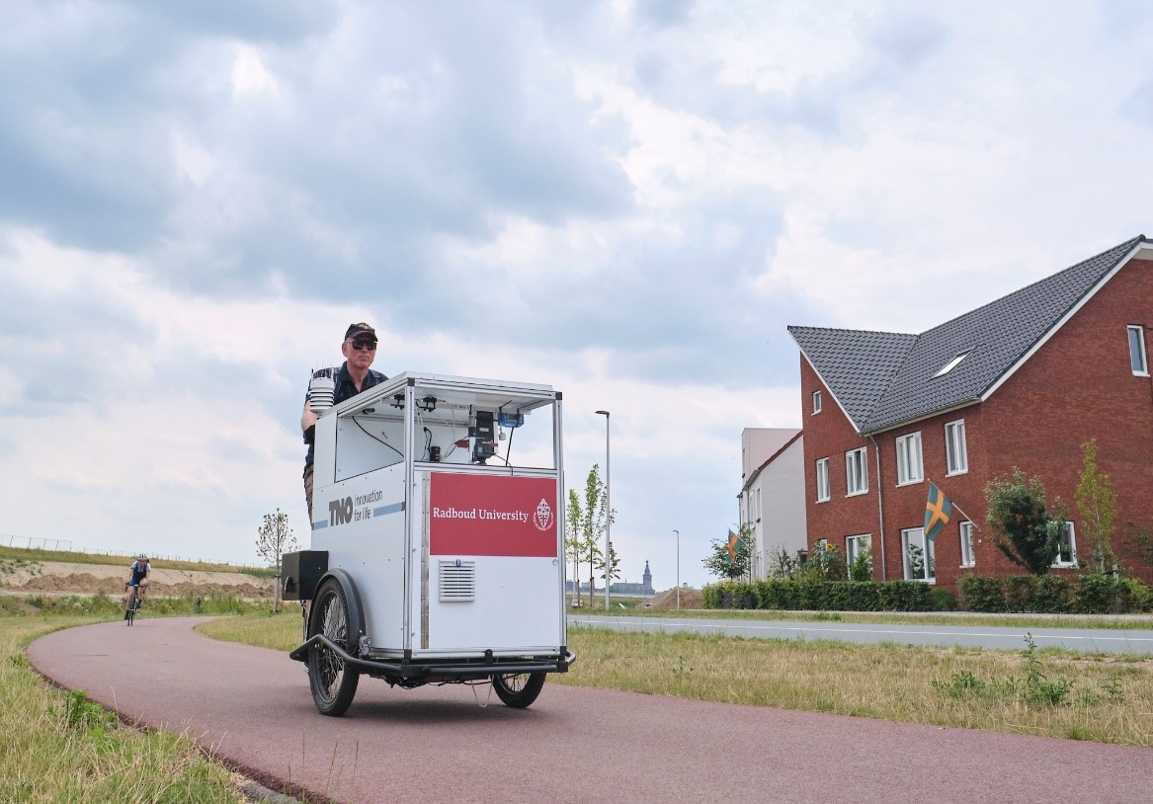
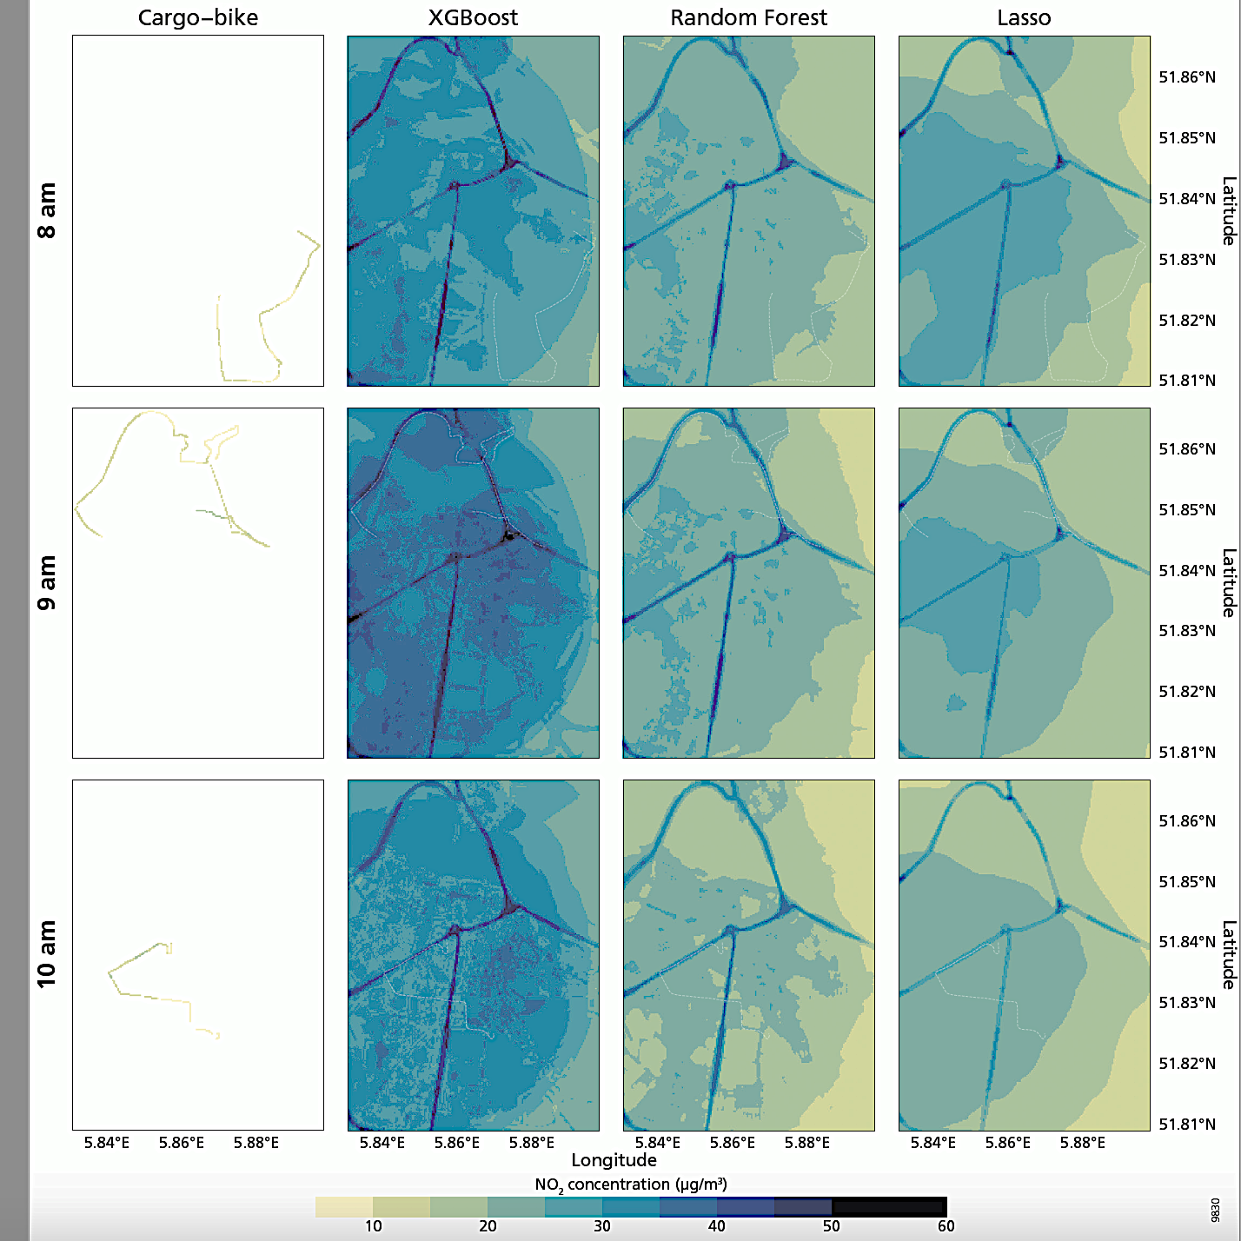
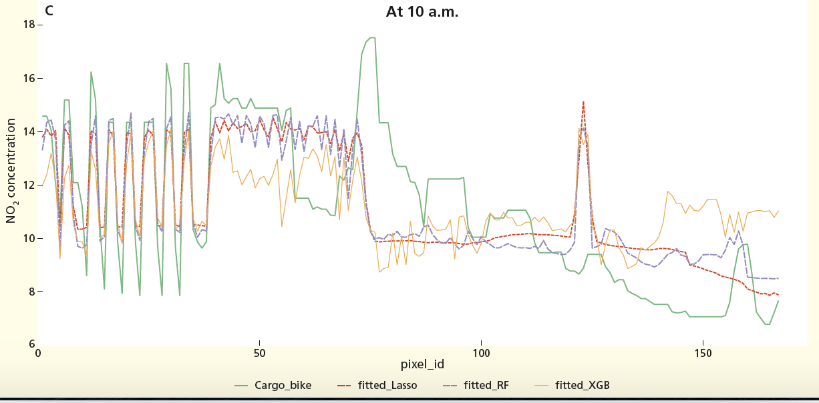
Further validation: cargo-bike measurements

Slide 15
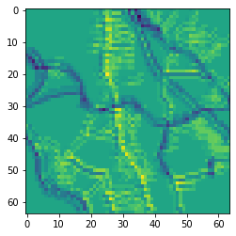
Statistiacal challenges in global-scale spatiotemporal regression
Challenges
Spatially heterogeneous predictor-response relationships
Integrate more spatial information
Involving time
On-going
Temporally-resolved and hierarchical modelling.
Road density
Road structure

Slide 16
In the workshop
1. Introduction and data (10%)
2. Statistical modelling techniques (70%)
3. Modelling process in practice (20%)
Querying and processing OpenStreetMap,
hyperparameter tuning,
cross-validation, mapping, model comparison
Start:
Ensemble tree-based ML
Deal with overfitting:
Regularization
Post-processing
More spatial information:
Mixed-effect models,
Deep convolutional NN

Slide 17
Thank you
https://github.com/mengluchu/OpenGeoHub2020

Slide 18
1. Introduction to global air pollution mapping, challenges and data exploration hands-on (10 mins): “getting ready” install packages, visualize data, data exploration: e.g. paired correlations, spatial dependence 2. Machine learning methods hands-on + break (30 mins): “machine learning methods.” ensemble trees, regularization and postprocessing, mixed-effect models, convolutional neural networks 3. Modelling process
hands-on (10 mins): “modelling process” hyper-paramter optimization, bootstrapping-based cross-validation, mapping and compare spatial patterns of different predictions 4. Deep convolution neural networks
This part is based on Python, I will share a Kaggle notebook for this. Another option is Anaconda environment, but is less convenient.

Slide 19
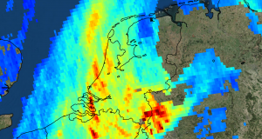
Tropomi
NO₂, O₃ (7km × 28km), SO₂, methane and CO
Electromagnetic field:
ultraviolet and visible (270–500 nm), near-infrared (675–775 nm), shortwave infrared (2305–2385 nm).
zoom in mode: 7 km × 3.5 km
5.5 km x 3.5 km since 2019

Slide 20
Questions
How can we …
efficiently assimilate data from different data sources (measurements from different sensors and predictors with different resolutions)?
model the heterogeneities between areas (e.g. city, country)?
model the effects of road infrastructures (since station measurements are point data)?

Slide 21
Sentinel 5p
Launched 2017 (5-10km)

Slide 22
In the workshop
Air pollution mapping:
more details about problems in global prediction and data
Statistical techniques:
Start:
Ensemble and boosting trees → Regularization (ElasticNet, XGboost)
Tackle more of the challenges:
- Improvement of modelling process: Post-processing
Aggregating trees using regularized regression
- Hierarchical models:
Mixed-effect models, (Deep) convolutional NN (as in computer vision)
Comparison and relationships between techniques
Modelling process in practice:
Querying and processing OpenStreetMap, data wrangling, hyperparameter tuning, cross-validation, mapping

